Slide 1
Coping with Stress in every day life
Occupational Therapy Conwy Community mental health team

Slide 2
What does being Stressful mean to you?

Slide 3
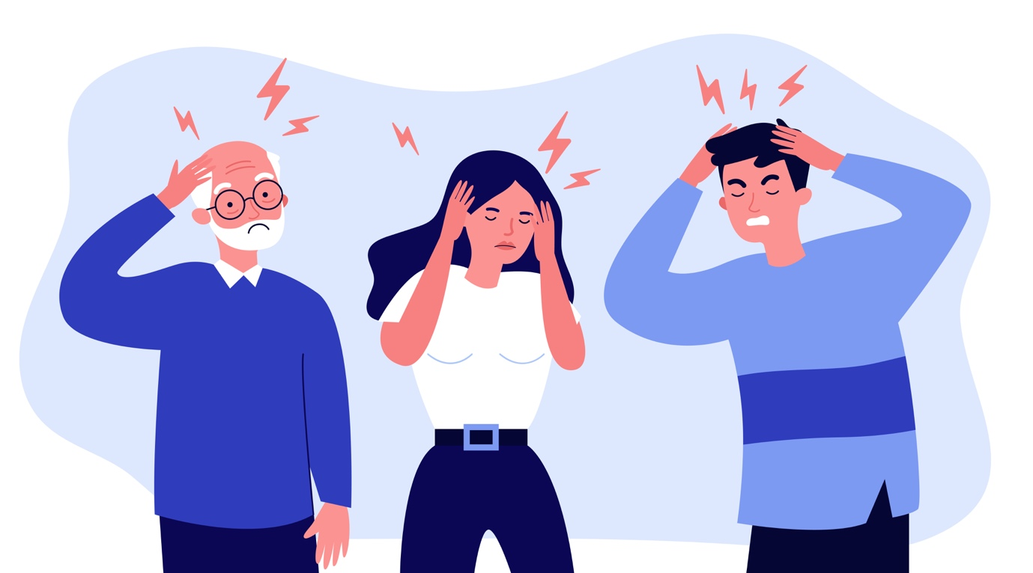
What is Stress?
We will often talk about feeling stressed or stressed out.
Stress is part of our daily life in one form or another as a result of more complicated / demanding lives and expectations.
When these demands and expectations become too much for us as individuals our bodies start to respond with an heightened emotional state.

Slide 4
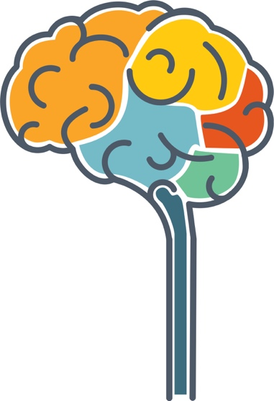
Fight/Flight Response
The fight, flight or freeze response was a tool that developed many thousands of years ago and is essential in keeping us safe from danger
At times of perceived threat the brain will send messages to our nervous system to get our body prepared
Parasympathetic or Relaxation system
Sympathetic or Fight, Flight or Freeze system
Heart beating faster Backache
Breathing faster Tight chest
Twitching muscles Muscle tension
Going to the loo more Dry mouth/ difficulty swallowing
Feeling sick Pin & Needles in hands & feet
Butterflies in stomach
Pupils constrict and return to normal
Stimulated saliva production
Inhibits sweat secretion
Breathing returns to normal rate
Slows heartbeat
Stimulates intestine mobility

Slide 5
What do the group feel causes Stress?
Change in routine
Housework / lack of ability to organise self and environment
Debt, paying bills and benefit reviews
Hunger / physical illness
Christmas
Retirement
Divorce / other relationship difficulties / lack of positive relationships
Child leaving home / pregnancy & becoming a parent
Marriage
Too high personal expectation and / or expectations of others
Sense of not being in control or involved in decisions affection your life

Slide 6
Three stages of Stress!
Stage 1: Normal Stress Response
  Starts Flight/Fight Response
  Increased Heart rate
  Butterflies
  Stomach Churning
  Short lived - goes away once situation finished

Slide 7
Three stages of Stress!
Stage 2: Prelonged or Additional Stressors
  Always on state of alert
  Body working harder - means always tired
  Unable to sleep / feel restless
  Decreased Memory
  Susceptible to illnesses e.g. Headaches, IBS, Migraines
  Psychologically tired / under the weather
  Response - more Alcohol, increased smoking, chocolate

Slide 8
Three stages of Stress!
Stage 3: Exhaustion of Energy Reserves
Immune system depleted – Big effect physically and mentally
Increased drinking ? Smoking
Irritation / Angry / Over-reacting
Vulnerable to infection
Pre-existing conditions flare-up e.g. Asthma, Eczema, IBS & Heart conditions

Slide 9
How Stress affects our Emotional & Mental Health
Anxiety
Low mood
Guilt
Shame
Sensitivity to others comments
Decision making
Poor concentration
Forgettfulness

Slide 10
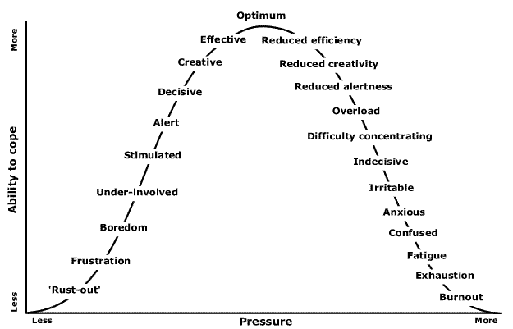
How Stress affects the way we Behave and Perform
Avoiding people & situations
Becoming more irritable
More emotional outbursts
Changing in eating habbits
Increase alchol and drug use
Smoking more
More sick days

Slide 11
Break
5mins comfort break

Slide 12
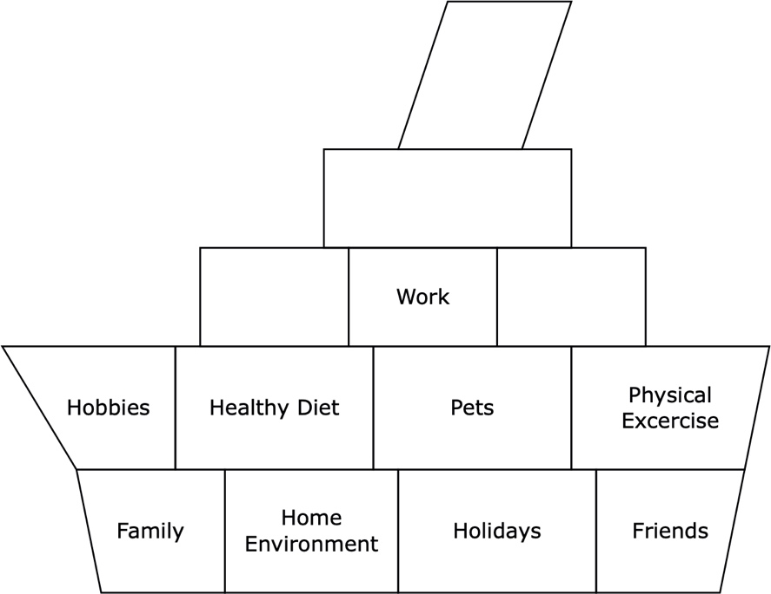
Understanding Stress
Well if we think of our lives as the ship. If we have only one compartment / area in our life, let’s say work, and work becomes difficult, then we can become mentally poorly.
However, if we took the same ship and added lots of different compartments / area in our life’s like hobbies, family and a healthy diet these things will support us through the tougher times.
© 2021 Hywel Mortimer-Roberts All Rights Reserved

Slide 13
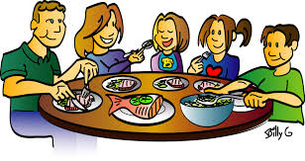
Having a balanced diet
Eat regularly
Stay hydrated
5 a day
Protein
Eat the right fats
Manage Caffeine
https://youtu.be/CSHO9VdVRfg - Mind
https://www.bda.uk.com/food-health/food-facts.html - UK Dietitians

Slide 14
Exercise
Exercise is a great way of releasing the unwanted muscle tension caused by having too much adrenaline in our bodies when we are stressed and anxious
Government guidelines suggest that adults between 19 and 64 should be doing at least 2 ½ hours total of moderate exercise a week e.g ½ dancing – ½ brisk walk – ½ gardening – ½ swimming – ½ house work
The benefits of excise include:
A sharper memory
Higher self-esteem and confidence
Promote better sleep
More energy
Boosts your immune system and reduces the impact of stress
Please find below the link to NHS Fitness Studio exercise videos: https://www.nhs.uk/conditions/nhs-fitness-studio/

Slide 15
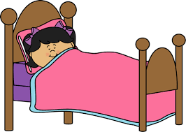
Sleep Hygiene
Stress can affect our sleep, leaving us with too little sleep. This lack of sleep can have long and short term affects such as our mood the following day, how we perceive things, irritability, lack of motivation and a reduced sex drive.
Tips to improve the quality of your sleep!
Going to bed & getting up at the same time everyday
Get some natural sunlight during the day
Get some exercise but not 3hrs before bed
Avoid stimulants ie. caffeine, alcohol & nicotine
Be tech savvy
Check Medication

Slide 16
How good are you at looking after yourself?
Scoring 3 2 1 0 Very like me Like me Unlike me Very unlike me
I occasionally give myself something nice like a present of treat
I make time to do relaxation activities
I believe it is necessary to be selfish at times
I like it when others look after me when I am ill
I plan events in my life that I can look forward to, such as holidays and outings
Every day I make sure I have some time to do something pleasurable for myself
I make a point of looking after my appearance and health
I like it when somebody gives me a present of compliments me on something I’ve done
I can praise myself if I think that I have done a good job
I feel in control of my life, I do not simply live my life according to what other people want
I make a point of eating a healthy diet and do not skip meals
I deliberately engage in exercise and keep myself physically fit
I deliberately make time to cultivate friendships with people I like
I make time to engage in absorbing, meaningful hobbies and activities
Sometimes I have to put my own needs first which means I may have to hurt others
I can say ‘no’ when people make demands on me
Total
Scoring: scoring less than 25= you certainly need to improve your self-care skills
The Mental Health Handbook © T Powell 2009

Slide 17
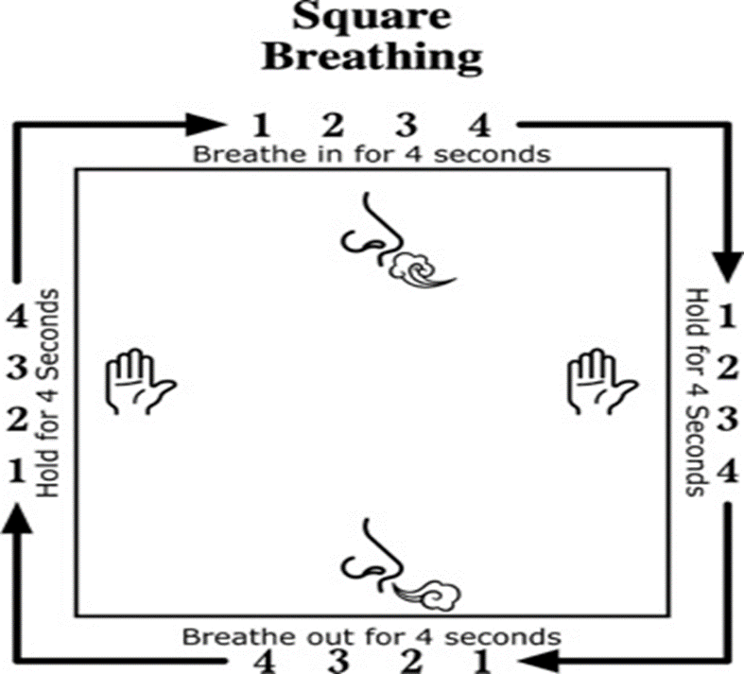
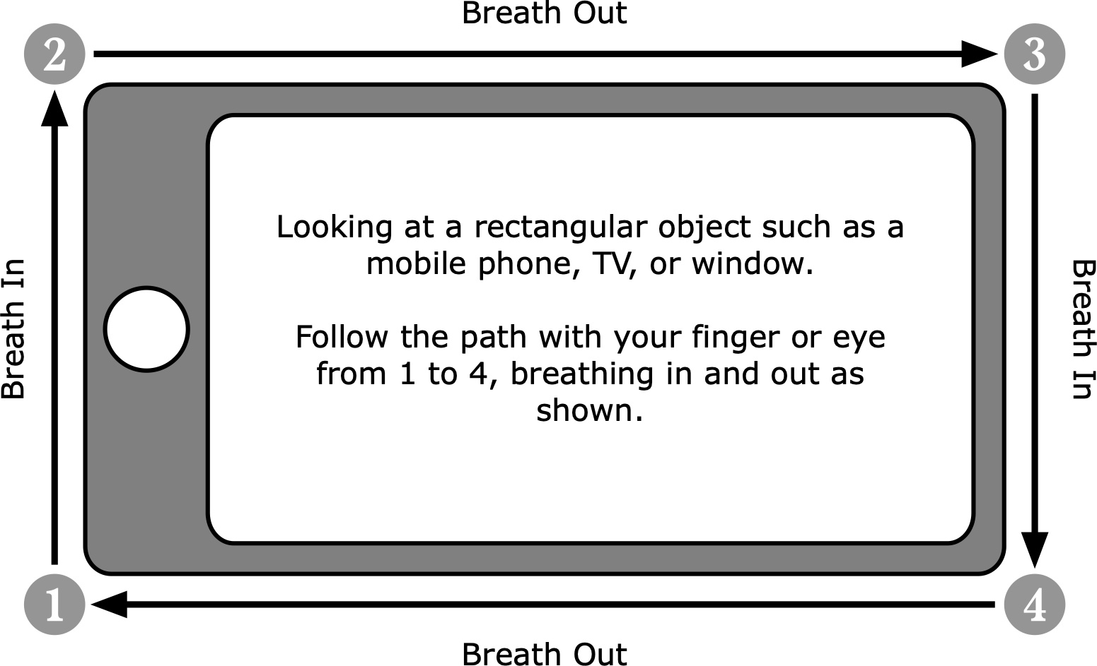
Breathing Techniques
© 2021 Hywel Mortimer-Roberts All Rights Reserved

Slide 18
Making positive change & Goal setting
At times of high stress day to day problems can seem insurmountable.
The following is a good way of starting to address these problems one by one.
What is the problem ? , why did it occur?, how do I feel about it?, and What do I want to change?.
List all the possible solutions, even those that seem unlikely.
Look at each solution and note what are the benefits and consequences.
Ask yourself is the solution
Legal
Safe
Fair
How would others feel about the solution
What support or resources do you need and plan out how you will carry out your solution using the goal planning information
How did it go and what did you learn . If it was unsuccessful chose another option on your list.

Slide 19
Goal planning
Goal | Take up a new hobby and make friends
Action steps | Date
Contact local community centre / library & gym to find out what activities are going on there | By the end of next week
Consider activities & chose which one I would like to pursue | 2 days to consider
Contact activity location & arrange to go & meet a member of staff to find out more about activity, familiarise self with location & plan starting date | In 1 weeks time
Contact family member to arrange to go with me for first session only | Phone next day
Attend first session with support | On planned date
Continue to attend independently | The next week

Slide 20
Resource information
Alcohol
Smoking
Housing support
Information on budgeting
Relaxation

Slide 21
Close & evaluation
Thank you very much for attending
We will be sending you a follow on email with an evaluation link
This should only take maximum of 4mins

Slide 22
Copyright © 2021 Cathy Glover & Mark Morris All rights reserved
Pictures unless stated under licence freepix.com
The authors cannot take responsibility for third sector information on placed on the internet

